Slide 1
English Project
By Avanish Murkute
Class 6th B
Roll no. 12

Slide 2
InformationAbout Ila Sachani

Slide 3
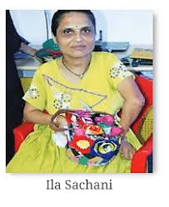
Who is Ila Sachani? Ans –Ila Sachani,a talented Kathiawar embroidery artist, overcome physical challenges to excel in her craft. She learned embroiderty using her feet under the guidance of her mother and grandmother. Illa”S skills were awards. recognized at a state exhibition, leading to national recognized and

Slide 4
Family Members of Ila Sachani Father-Vaivasvata Manu. her Mother-Shrdha Manu. Siblings-Ikshvaku and 9. Children-Pururauas(son as a woman) Vinatashva(sons as a man)

Slide 5
What was so special about Ila Sachani? Ans=The first,Ila Sachani, stood behind a stall displaying embroderty so intricate that one couldn”t tell it was done by a person, who is unable to use her hands. She was born with a deformity that rendered her arms unless. So, she taught her feet the art of making fine patterns In traditional embroiderty.

Slide 6
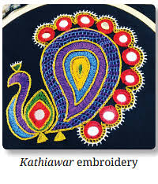
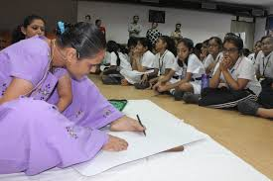
She learned many styles even ones from outside Gujarat-Kachhi, Kashiri and Lucknawi

Slide 7
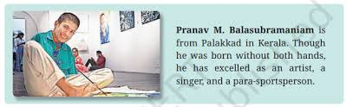
Ila Sachani learned her skills from Pranav M.Balsubramaniam

Slide 8
Thank you

